Slide 1

Chronic Kidney Disease Classification
Machine Learning Approach
Problem Statement 7 (PS-7)
Team mates:
CB.EN.U4EEE22039 - Priyen S I
CB.EN.U4EEE22059 - Akshit Ghunawat
CB.EN.U4EEE22160 - Lingeswar S
CB.EN.U4EEE22165 - Mitun T S

Slide 2
Introduction
Chronic Kidney Disease (CKD) is a life-threatening condition.
Leads to the decline of Glomerular Filtration Rate (GFR) over 3+ months.
Early detection can help slow disease progression.
Machine Learning (ML) can aid in classification and early diagnosis.

Slide 3
Problem Statement
CKD often goes undiagnosed until later stages.
Symptoms are subtle: fatigue, swelling, decreased urine output.
Early detection can help prevent complications.
Goal: Use ML models to classify whether CKD is present or not.

Slide 4
Dataset
Dataset from UC Irvine Machine Learning Repository.
Features: Age, Blood Pressure, Specific Gravity, Albumin, Sugar, etc.
Target: Presence or Absence of CKD.
Includes numerical and categorical attributes.

Slide 5

Methodology
Step 1: Import Libraries
Step 2: Load and Visualize Raw Data
Step 3: Data Cleaning & Preprocessing
Step 4: Handle Missing Values
Step 5: Feature Scaling & Train-Test Split
Step 6: Train Multiple Models
Step 7: Make Predictions
Step 8: Evaluate Models & Display Confusion Matrices

Slide 6
Machine Learning Models Used
Logistic Regression
Support Vector Machine (SVM)
Random Forest (Tuned with Grid Search)
Gradient Boosting Classifier

Slide 7

Performance Metrics
Accuracy
Precision
Recall
F1-Score
Confusion Matrix

Slide 8
Results and Comparison
Random Forest (Tuned) achieved the highest performance.
F1-Score and Specificity were considered for model selection.
Confusion Matrix analysis to assess misclassifications.

Slide 9
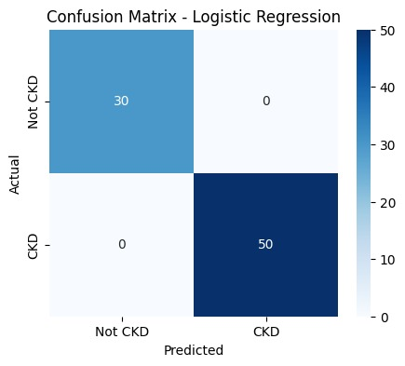
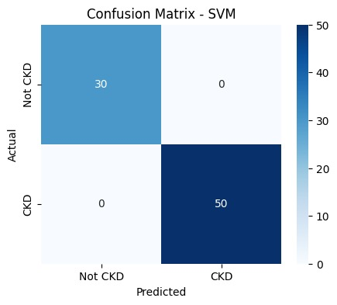
Comparison
Logistic Regression
Support Vector Machine

Slide 10


Gradient Boosting
Random Forest

Slide 11

Conclusion
Machine Learning can help in early detection of CKD.
Random Forest with hyperparameter tuning performed best.
Precision, Recall, and Specificity were maximized.
Future work: Deploy as a clinical decision support system.

